Slide 1

DevOps/IaC Session
Pied Piper Program
2nd August 2017
Alberto Ramos
@AlbertoSyd

Slide 2

Prerequisites
In addition to the Agile session prerequisites:
Install Vagrant on Windows laptop
Download VMs: XtremIO, Centos65, CoprHD
Install Postman and JSON viewer
Create an AWS account
Notes:
Mention the Digital and IT Transformation: Modernize, AUTOMATE, Transform

Slide 3
Agenda
Introduction:
Configuration Management
Vagrant
Ansible
REST APIs
XtremIO API
Redfish API
Composable Infrastructure
Notes:
Mention the Digital and IT Transformation: Modernize, AUTOMATE, Transform

Slide 4

This couldn’t happen here …
- Knight Capital Group
- Largest trader of US equities
- 17% market share
- 3.3 Billion trades daily
- 21 Billion dollars
- Own $365 million in cash and equivalents
1st July 2012
Notes:
https://dougseven.com/2014/04/17/knightmare-a-devops-cautionary-tale

Slide 5

- New York Stock Exchange
- Due to launch RLP program on 1st August
- To improve liquidity for retail investors
- Knight updating SMARS high speed execution system
July 2012
- Knight developed software tool
- Gets large orders from trading platform
- Breaks them into smaller child orders
- Finds buyer/seller match
SMARS
Notes:
https://dougseven.com/2014/04/17/knightmare-a-devops-cautionary-tale

Slide 6
- SMARS new code testing is complete
- New version of SMARS is ready for deployment
- New deployment needs also to remove "Power Peg"
20th July
But …
he forgets
to remove the old code
from one server
- Knight starts deploying new code
- To 2 servers per day, to a total of 8
- Deployment process, "single" engineer to:
“Manually” update new code
“Manually” remove the "Power Peg"
27th July
Notes:
https://dougseven.com/2014/04/17/knightmare-a-devops-cautionary-tale

Slide 7
9:30 am – Market Opens
- SMARS starts routing orders, but …
- One server doesn't track the executed orders against parent
- RESULT: High speed trading on an endless loop
9:31am - Everyone in trading floor feels something is not right
9:32am - Everyone knows something is VERY wrong
9:33am - Everybody wonders why the people behind the error
... don't pull the plug!
- Knight trading volume keeps growing
1st August 2012
Notes:
https://dougseven.com/2014/04/17/knightmare-a-devops-cautionary-tale

Slide 8

- Knight developers try to troubleshoot the live system
- They cannot figure out what's wrong … so
- … they pull out the new code from all servers
RESULT - 8 servers running Power Peg instead of 1
- Knight now represents 50% of the total traded volume
- Over-buying is lifting value of some stocks by 10%
- and sinking others by that much
A bit later
Notes:
https://dougseven.com/2014/04/17/knightmare-a-devops-cautionary-tale

Slide 9
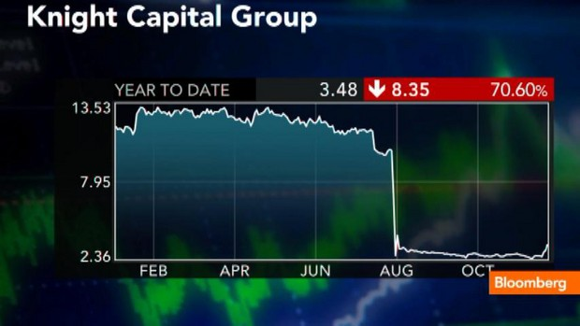
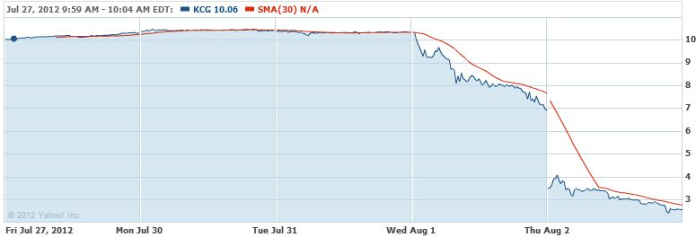
- 45 minutes of hell are over
- SMARS has performed 4 million transactions
- and transacted 397 million shares
- For a net loss of 460 million dollars
10:15am
- Knight Capital Group gets acquired by Getco LLC
- The new company gets renamed KCG Holdings
December 2012
Knight shares have dropped 66%
2nd August
Notes:
https://dougseven.com/2014/04/17/knightmare-a-devops-cautionary-tale

Slide 10
Infrastructure Automation

Slide 11
Quick Recap - What is DevOps?
A Culture that emphasizes
Collaboration/communication between Dev and QA and IT Ops
Automating the process of software delivery and infrastructure changes

Slide 12
Where to Begin
3 Phase IT Transformation Process
Modernize
Automate
Transform
Leverage Modern Infrastructure
Right tool for the job
Simple & Powerful
Self-service provisioning capabilities
Running IT like a service provider/public cloud
With Senior Exec Support
Transform
People
Process
Business & IT Alignment

Slide 13
Infrastructure Automation – Why?
Critical for Web 2.0 application that
Run on thousands on instances
Do continuous delivery
With the adoption of cloud there is an increased push for automation to realize the value of a cloud architecture, not just for Web 2.0
Infrastructure automation provides
It minimizes errors
It ensures consistency
It improves agility
Notes:
Dockerized environments are great but there are still lots of mission critical apps running on bare metal x86, iSeries, big Unix and Mainframe

Slide 14
Infrastructure Automation – What?
“It is the process of scripting environments:
from installing an operating system
to installing and configuring servers on instances
to configuring how the instances and software communicate with one another, and much more”
Most definitions forget about the “hard tin” (storage, network, server hardware)
It is easier to automate/orchestrate abstracted infrastructure
Don’t want to deal with different hardware from different vendors
Can we bring some of the same principles to automate the hard tin?

Slide 15
Infrastructure Automation – How?
Configuration management tools, ex: Chef, Puppet, Ansible, Salt
Image management: Vagrant, Packer, Terraform
Infrastructure-as-a-Service tools, ex: Vmware vRealize Suite, Openstack
RESTful API’s
Composable Infrastructure
Storage as a Service - ViPR
Notes:
Infrastructure as code (IaC) is the process of managing and provisioning computer data centers through machine-readable definition files, rather than physical hardware configuration or interactive configuration tools

Slide 16
Configuration Management

Slide 17
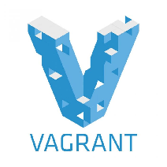
Vagrant
Build and maintain virtual portable virtual environments, called “Boxes”
Allows you to reproduce development environments
It uses a declarative config file, “Vagrantfile”: Image, networking, RAM, folders, …
Requires a “provider” such as Vmware, VirtualBox, Docker, AWS, …
Images are provider specific
Public catalog of Vagrant boxes, called “Atlas”: http://www.vagrantbox.es/
Boxes support versioning. Creator can push fixes easily
Integrates with configuration management tools, called “provisioners”: Puppet, Ansible, …, or simply shell (Linux) and Powershell, batch files (Windows)

Slide 18
Lab 1: Vagrant
Install Vagrant and clone repo https://github.com/cermegno/vagrant-lesson
Open a DOS prompt. Create directory and “cd” into it
For “Atlas” deployments (http://www.vagrantbox.es):
vagrant add box_name http://??? ← Don’t do this! Too many downloads
Vagrant init box_name ← Vagrantfile created
Or if you have a Vagrantfile, just place it in the directory (ex: Vagrantfile-1)
If using a local image edit Vagrant file (ex: the centOS 6.5 box you got)
config.vm.box_url = "file://centos65-x86_64-20140116.box“
Deploy the box vagrant up
Notes:
The source image files that have been downloaded live in 'c:\users\{user}\.vagrant.d\boxes' directory
Should I download the boxes in advance? Yes. To use local box, place the box file in the same directory as Vagrantfile and add this line
config.vm.box_url = "file://core-197.0.0-kvm.box“
Or place it somewhere else and specify the path
config.vm.box_url = "file:///temp/core-197.0.0-kvm.box"

Slide 19
Lab 1: Vagrant
Login: vagrant/vagrant, root/vagrant, no sudo password
Vagrant folder shared with host machine (current dir -> /vagrant)
Portability/duplicability of the box: ensure the “.vagrant” folder moves along
Box format gets unpacked in 'c:\users\{user}\.vagrant.d\boxes' directory
Vagrant box list
Vagrant reload
Vagrant destroy
Vagrant box remove
C:\Program Files\Oracle\VirtualBox\vboxmanage list vms
Notes:
The source image files that have been downloaded live in 'c:\users\{user}\.vagrant.d\boxes' directory
Should I download the boxes in advance? Yes. To use local box, place the box file in the same directory as Vagrantfile and add this line
config.vm.box_url = "file://core-197.0.0-kvm.box“
Or place it somewhere else and specify the path
config.vm.box_url = "file:///temp/core-197.0.0-kvm.box"

Slide 20
Lab 1: Vagrant
Going beyond a default installation. Rename the examples in:
https://github.com/cermegno/vagrant-lesson
Configure port forwarding in VirtualBox (check VM settings in VirtualBox)
Configure Public and Private networks
Configure a folder to be synced
Run a provisioner
Install software, configure users, copy files, configure services, …
To rerun only the provisioner section you can run vagrant provision
MultiVM deployment
Notes:
The source image files that have been downloaded live in 'c:\users\{user}\.vagrant.d\boxes' directory
Should I download the boxes in advance? Yes. To use local box, place the box file in the same directory as Vagrantfile and add this line
config.vm.box_url = "file://core-197.0.0-kvm.box“
Or place it somewhere else and specify the path
config.vm.box_url = "file:///temp/core-197.0.0-kvm.box"

Slide 21
Lab 1: Vagrant
This is how you package a box
Shutdown source “box” and create a copy of directory and “cd” into it
Add to Vagrantfile: config.ssh.insert_key = false
vagrant package --output test.box --include file1, file2
When deploying it, don’t forget to adjust networking again
Notes:
The source image files that have been downloaded live in 'c:\users\{user}\.vagrant.d\boxes' directory
Should I download the boxes in advance? Yes. To use local box, place the box file in the same directory as Vagrantfile and add this line
config.vm.box_url = "file://core-197.0.0-kvm.box“
Or place it somewhere else and specify the path
config.vm.box_url = "file:///temp/core-197.0.0-kvm.box"

Slide 22
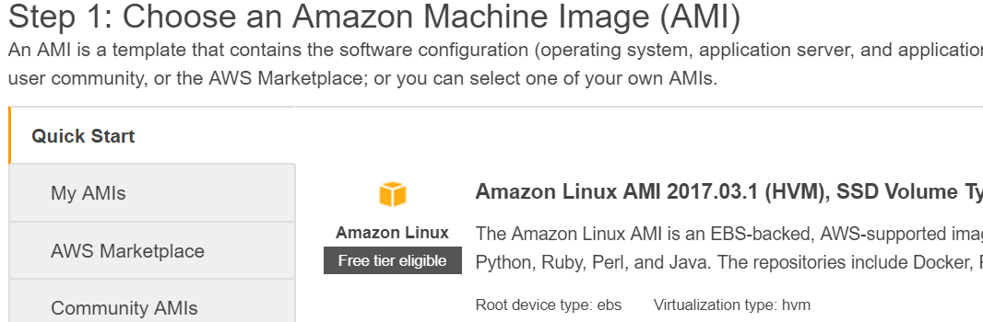
Intro to AWS EC2
Log on to AWS: https://console.aws.amazon.com/console/home
Select: Services -> Compute -> EC2
Click on Instances -> Launch an Instance (Explore Marketplace/Community AMI)
Select Amazon Linux AMI -> Explore options (size, storage, security …)
Review and Launch
See it in “Instances”

Slide 23
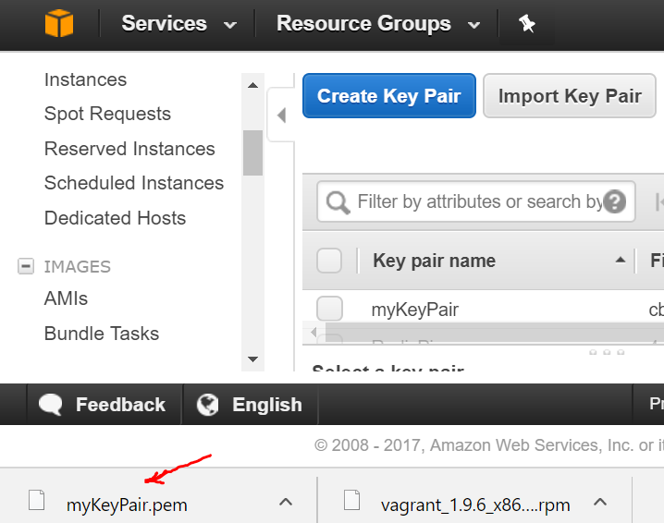
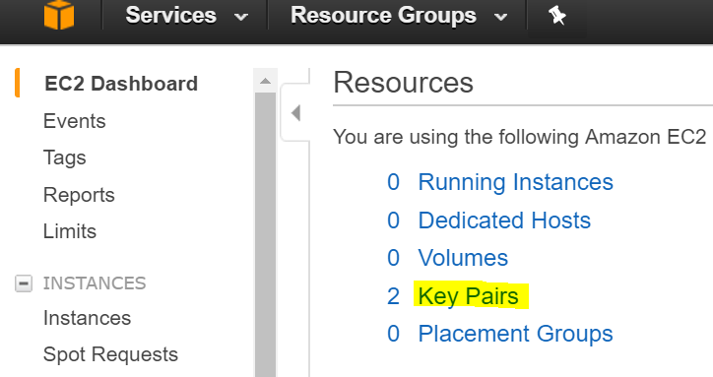
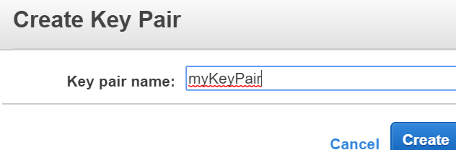
Intro to AWS EC2
Remote access to EC2 instances is done through certificates
Click Key Pairs -> Create Key Pair
Select a name and click Create
The public key is downloaded
ssh –i cert.pem user@dns.name
Putty requires converting the key
Security group must allow SSH
Notes:
Using Putty is a bit more painful. You need to convert the public key.
https://docs.aws.amazon.com/AWSEC2/latest/UserGuide/putty.html?icmpid=docs_ec2_console
https://alestic.com/2014/01/ec2-ssh-username/

Slide 24
Lab 2: Vagrant in AWS
Providers other than the default (VirtualBox) require a plug-in
Install the plug-in
vagrant plugin install vagrant-aws
From https://github.com/mitchellh/vagrant-aws copy vagrant box add dummy ???
AWS provider uses AMI images (Region specific). No uploads = dummy.box
Different providers have provider-specific options. Ex: AWS networking
Copy aws\Vagrantfile-Windows into your directory
Edit access keys, EC2 key, AMI name and size, matching username, full path to pem
Deploy with Vagrant in AWS as usual: vagrant up
Requires SSH access to AWS
Notes:
https://alestic.com/2014/01/ec2-ssh-username/
https://github.com/mitchellh/vagrant-aws
Most complete article with details on how to do this:
https://oliverveits.wordpress.com/2016/04/01/aws-automation-using-vagrant-a-hello-world-example/

Slide 25
Lab 2: Vagrant in AWS
The synced folder feature requires NFS or rsync
Rsync must be on the path of vagrant host. Easier on Linux
Can set “disabled: true” and copy files via other methods, ex: wget
In Linux, in order to Rsync to work, must edit:
vi /opt/vagrant/embedded/gems/gems/vagrant-1.9.6/plugins/synced_folders/rsync/helper.rb
And remove/comment out the following:
control_options ="-o ControlMaster=auto -o ControlPath=#{ctrlpath} -o ControlPersist=10m“
To install Vagrant in Linux:
wget https://releases.hashicorp.com/vagrant/1.9.6/vagrant_1.9.6_x86_64.rpm
rpm -ivh vagrant_1.9.6_x86_64.rpm
Notes:
In order to implement the shared folder functionality we need rsync
https://www.vagrantup.com/docs/synced-folders/rsync.html
This the process to use Vagrant with AWS in Linux
yum install wget
wget https://releases.hashicorp.com/vagrant/1.9.6/vagrant_1.9.6_x86_64.rpm
rpm -ivh vagrant_1.9.6_x86_64.rpm
mkdir aws-vagrant
cd aws-vagrant/
vagrant plugin install vagrant-aws
vagrant box add dummy https://github.com/mitchellh/vagrant-aws/raw/master/dummy.box
## Need to copy the key file (blah.pem) into the Linux machine
chmod 400 Vagrant.pem
Need these in the Vagrantfile (make sure you use the matching username for the instance you are provisioning). The Vagrantfile will need to reference the absolute path to the pem file
override.ssh.username = "ec2-user"
override.ssh.private_key_path = "/root/aws-vagrant/Vagrant.pem"
The "security group" assigned in AWS to the instance must allow ssh from the Vagrant host
Once the Instance is up you can ssh like this. This also what Vagrant does, so if something went wrong try this to troubleshoot. If you cannot log in like this you are using the wrong username, DNS name or key
ssh -i "/root/aws-vagrant/Vagrant.pem" ec2-user@ec2-52-11-232-136.us-west-2.compute.amazonaws.com <<-- Must be the DNS name

Slide 26

Configuration Management
What are they?
They are used to manage Infrastructure as Code
They use Recipes, Playbooks, Templates, …
Some are declarative. Others are procedural. Others both
Open Source with different commercial options available
How do you choose?
Features, support for different OS, GUI, Reporting
Learning curve. Written in different languages. Skills required to adopt
Maturity, stability
Agent based vs push mode
Support models, Price
Notes:
http://blog.takipi.com/deployment-management-tools-chef-vs-puppet-vs-ansible-vs-saltstack-vs-fabric/
Ansible vs. Chef vs. Fabric vs. Puppet vs. SaltStack
Which configuration management or deployment automation tool you use will depend on your needs and preferences for your environment. Chef and Puppet are some of the older, more established options, making them good for larger enterprises and environments that value maturity and stability over simplicity. Ansible and SaltStack are good options for those looking for fast and simple solutions while working in environments that don’t need support for quirky features or lots of OSs.

Slide 27
Puppet/Chef/Ansible/Salt
 | Puppet | Chef | Ansible | Salt
OS Support/Features | XXX | XXX | XX | XX
Maturity/Resilience | XXX | XXX | XX | XX
Scalability | XXX | XXX | XX | XXX
Simplicity | XX | XX | XXX | XX
Push or Client | Client | Client | Push | Client
Declarative/Procedural | Declarative | Procedural | Procedural | Declarative
Notes:
http://blog.takipi.com/deployment-management-tools-chef-vs-puppet-vs-ansible-vs-saltstack-vs-fabric/
Ansible vs. Chef vs. Fabric vs. Puppet vs. SaltStack
Which configuration management or deployment automation tool you use will depend on your needs and preferences for your environment. Chef and Puppet are some of the older, more established options, making them good for larger enterprises and environments that value maturity and stability over simplicity. Ansible and SaltStack are good options for those looking for fast and simple solutions while working in environments that don’t need support for quirky features or lots of OSs.

Slide 28
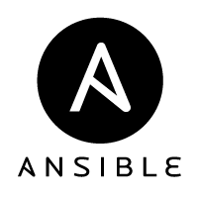
Ansible Introduction
Agentless automation. It uses SSH
Simple. Human-readable playbooks (YAML files)
Ad-Hoc tasks and Playbooks
Idempotent. Tasks are safe to run multiple times
It gathers “Facts” about the environment to determine if it needs to run the task
Modules vs Shell commands
http://docs.ansible.com/ansible/list_of_all_modules.html
It will integrate with ViPR Controller
Notes:
To learn more:
https://serversforhackers.com/an-ansible-tutorial

Slide 29
Lab 3: Ansible
Clone repo: https://github.com/cermegno/Ansible-test
Open “Ansible-Lab-Guide” with a text editor (Notepad++, Atom, …)
Select “Shell” syntax to take advantage of colour highlighting
Place the CentOS box provided into the directory that contains cloned repo
Open DOS prompt
cd {dir_with_repo_files}
vagrant up
After Vagrant deployment completes, follow instructions in the Lab-Guide

Slide 30
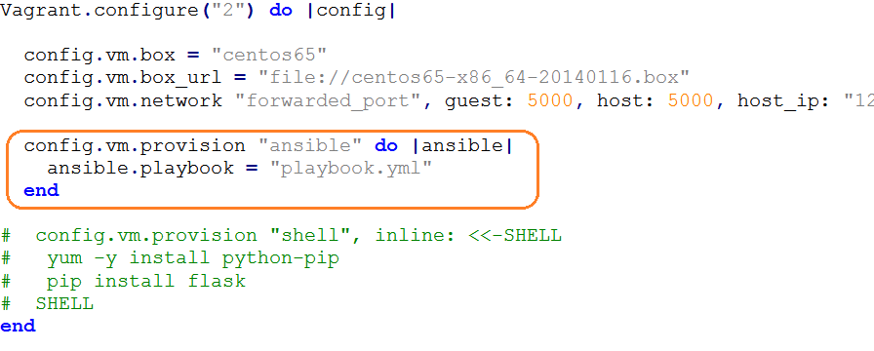
Ansible with Vagrant
Vagrant can use Ansible as a provisioners instead of ‘shell’
Notes:
To learn more:
https://serversforhackers.com/an-ansible-tutorial

Slide 31
Rest API Labs

Slide 32
Introducing REST API’s
REST API
Used to expose/access web services
Stateless. Uses HTTP as transport method
Could use REST client (like Postman) or CLI (cURL)
Or programmatically with a languages like Python, Ruby … by using URL libraries
Relies on HTTP’s CRUD operations: GET, POST, PUT, DELETE
We all have heard that word ☺ !!
But today you will play with it … a lot !!
Notes:
RESTful APIs explicitly take advantage of HTTP methodologies. They simply use:
- PUT to change the state of or update a resource, which can be an object, file or block
- GET to retrieve a resource
- POST to create that resource and
- DELETE to remove it.

Slide 33
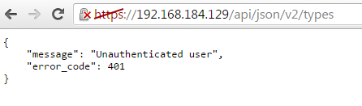
Accessing API’s
Normal browsers have limited control over request
They are not good tools to interact with API’s

Slide 34
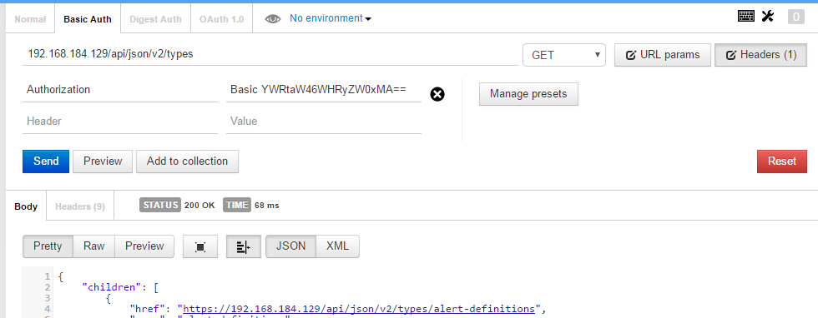
Accessing API’s
Postman and equivalents provide you the control

Slide 35
Lab 4 – Step 1
Clone repo - https://github.com/cermegno/GeekDay-Lab4
Run “pip install requests”. Run “step1.py”
What on Earth was that?
Uhmm, wrong question!!
What on Space was that?
Any ideas about the “Status Code”?
Also, what sort of output is that?
Open the code with IDLE and examine it
Notes:
another common language for interacting with API’s is XML. Most EMC products use JSON

Slide 36
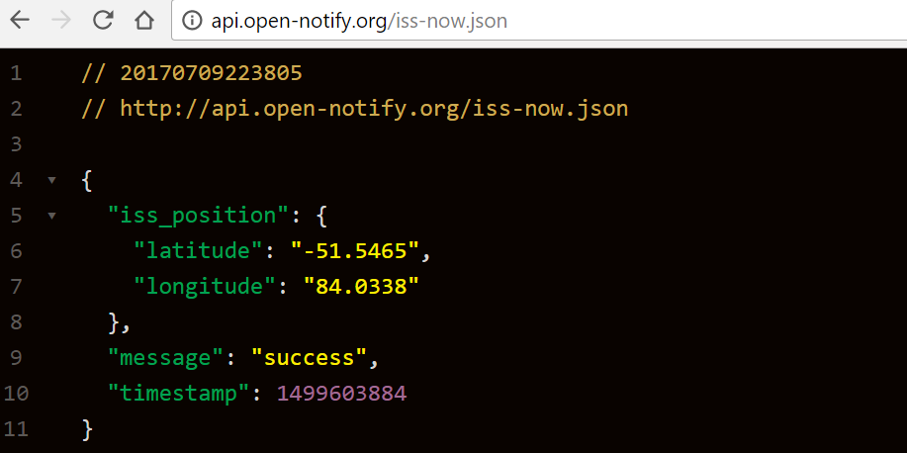
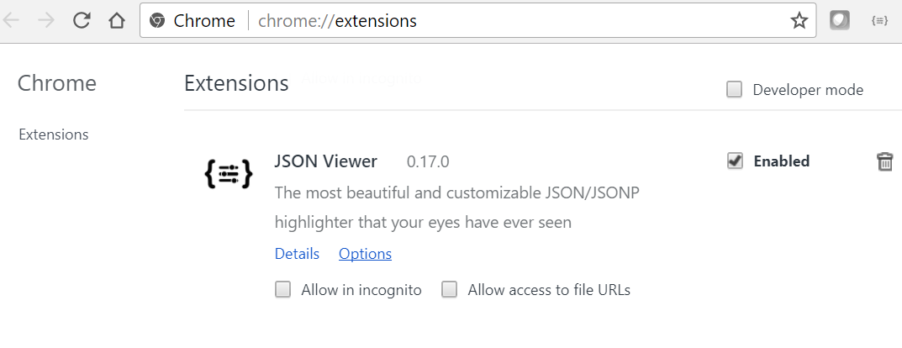
Lab 4 – Step 1
JSON Viewer Chrome extension displays nicer JSON

Slide 37
Lab 4 – Step 2
JSON outputs can be lengthy and complex
How do we extract data from it?
Open “step2.py” with IDLE
Run it
Can you extract the “longitude” instead?
What is the functionality of Python “type” command?

Slide 38
Lab 4 – Step 3
Some GET requests require you to pass parameters
Can you think of any examples? And within this API?
Plug in your city coordinates instead?
Taking “step2.py” as an example: what will be the “duration” during the “second” pass

Slide 39
API’s on DellEMC products
Available in every product
Recommended way to script (over CLI)
Different levels of maturity for different products
Often there is a contract with customers
Ex: XtremIO API will be compatible with current and previous version. Now we are on v2, but v1 commands are still functional
Authentication comes into play

Slide 40
Lab 5 – Step 1
Import XtremIO OVA
Make network->Adapter 2 = Host-only. Disable other adapters
Boot the VM and make note of the IP address in the console
Clone “GeekDay-Lab5” repo
Open “Step1.py” in IDLE
Notice the URI section of the query
Now run it by pressing F5

Slide 41
Lab 5 – Step 1
What is it showing?
Notice how the authentication is being passed
“Verify = False”, uhmm any ideas
There are ways of not showing the password

Slide 42
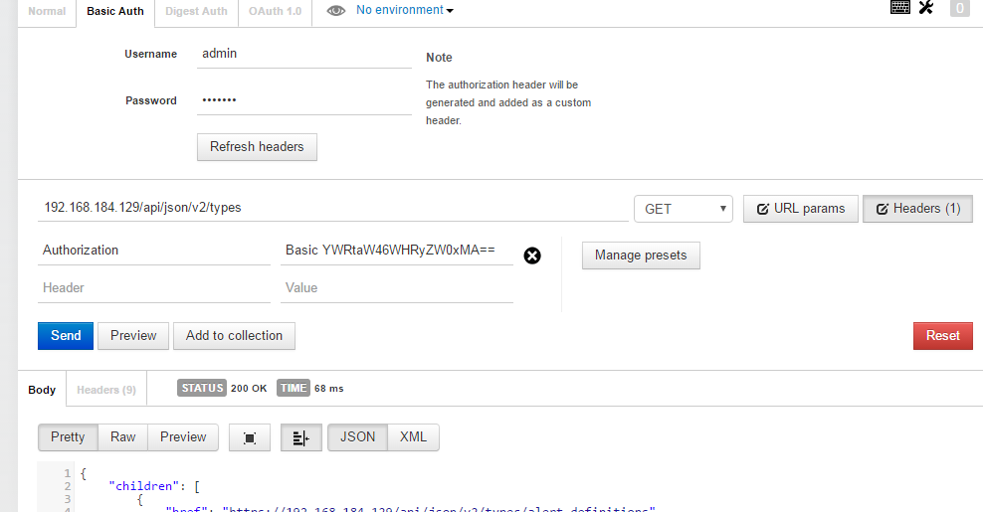
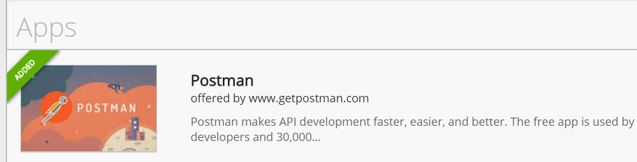
Lab 5 – Step 1
Chrome → More Tools → Extensions
Get more Extensions

Slide 43
Lab 5 – Step 2
Now take a look at the XtremIO REST API guide
Open “step2.py”
What do you think it is trying to do?
Run it
What about display general information about: clusters, initiators or DAEs?
What about displaying details of a single volume?

Slide 44
Lab 5 – Step 3
We now have some experience reading data
How do we go about modifying configuration?
Discuss what HTTP method would you use to create a new volume. And to modify an existing volume?
Open “step3.py” with IDLE
How are parameters passed? Look up the API guide
Did you get an error creating a new volume?
How would you work around it?

Slide 45
Lab 5 – Step 4
For bonus points …
Open “step4.py”
Can you extract from your new volume
Creation time
Volume unique ID
Volume size in GB

Slide 46
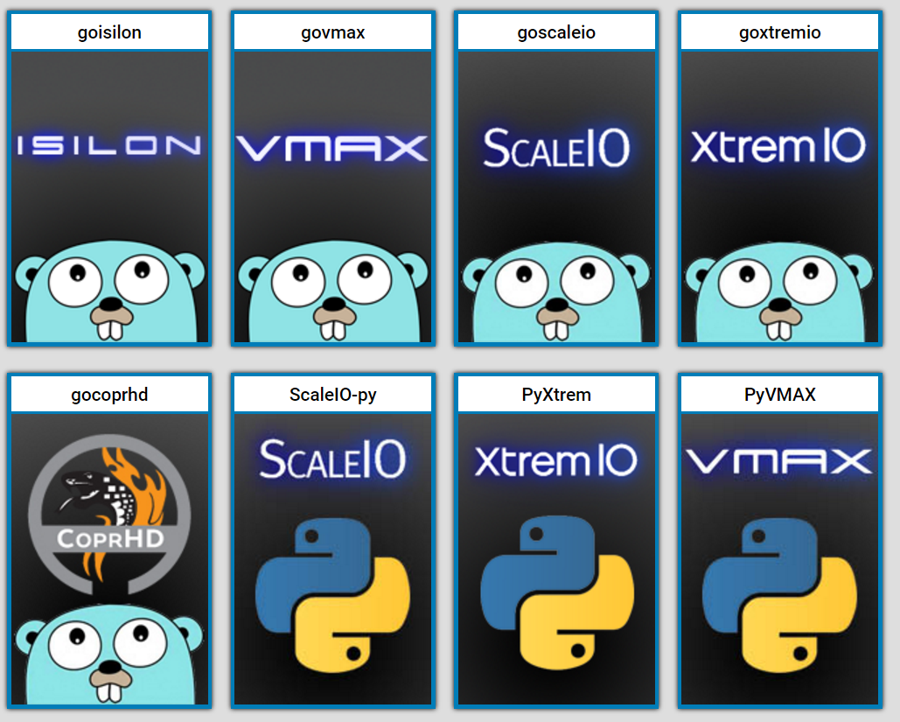
Can you make Rest API Friendlier?
DellEMC {code} community develops modules that simplify the consumption of Rest API’s of different DellEMC products
Sometimes also refered to as Libraries or Wrappers
Developed for various programming languages: Python, Go, Ruby, …
Open Source → You can participate too
https://codedellemc.com/

Slide 47
Lab 6 – Use PyXtrem to interact with XtremIO
Clone the PyXtrem repo https://github.com/cermegno/PyXtrem
Open “xtremOperationsLib.py” with IDLE
Create another a 5GB LUN
Verify with PyXtrem that your LUN was successfully created
How many nodes are there in the cluster?
How many disks?
Can you see the error about certificates we were getting in previous labs?

Slide 48
Compute Orchestration

Slide 49
DellEMC Poweredge Compute Orchestration
Traditionally done through Dell OpenManage or iDRAC (racadm scripts)
Now added support for Redfish API for 14G servers
Industry standard (DMTF). It facilitates composable infrastructure in the future
Also available on 13G with DRAC with Lifecycle Controller
There is an extension for storage done by storage vendors: Swordfish API
On Poweredge servers access through https://<iDRAC IP>/redfish/v1/
Redfish is a REST API which uses JSON and OData
OData standardizes the data format to implement a common interface across multiple vendors.
Notes:
https://blogs.sap.com/2013/10/03/lets-talk-odata-shall-we/
http://www.davidchappell.com/writing/white_papers/Introducing_OData_v1.0--Chappell.pdf
https://www.youtube.com/channel/UC2MIRFVOvpOo_hMT-TQU4gg

Slide 50
Redfish API

Slide 51
Redfish API – Exploring DMTF Mockups
Mockups available at
http://redfish.dmtf.org/redfish/v1
Rack-Mounted Server
Rack-Mounted Server with Local Storage
Bladed System
Simple SAS Fabric
Bladed Partitions
Composable System

Slide 52
Lab 7 – Use the Redfish API
Query API for data
Explore different branches to obtain hardware information
View events in the event log
Remote Reboot to:
Force a new system to see newly provisioned LUNs
There is no ability to just rescan HBA on existing system. Automate with Ansible instead
Install an OS on an empty server along with
Changing boot order, PxE
Mounting Virtual Media ?
Script available at: https://github.com/cermegno/Redfish-lesson
Video available at: https://youtu.be/jbERszfBK3I

Slide 53

OnRack/RackHD
Lots of innovation going on at the upper layers and at the hardware layers
If they are coupled it is hard to get benefit
OnRack provides low level hardware management and orchestration services for multivendor environments
Provides decoupling of physical and hardware layer
Automated discovery, update firmware/BIOS, remote boot, install OS, telemetry
Provides API for integration from other tools
Is it used by VxRack. Dynamically provision different stacks
RackHD is the Open Source version https://github.com/rackhd
https://rackhd.readthedocs.io
Notes:
Play the video of OnRack + SnapPack
https://youtu.be/atJuFBEhLA4
It uses a combination of uPXE boot, BMC and IPMI

Slide 54
One Final Word on API’s

Slide 55
Can you create your own Rest API?
Do you know how to create a web server? With GET and POST?
Do you know how to return JSON instead of HTML?
You don’t know how to implement authentication yet
But not all Rest API’s require it
Use API versioning, ex: /api/v1/{some-folder}
Provide a view to endpoints that branch out to help navigation
Implement a health-check endpoint. Is alive? Can check the version
Notes:
https://medium.com/studioarmix/learn-restful-api-design-ideals-c5ec915a430f

Slide 56
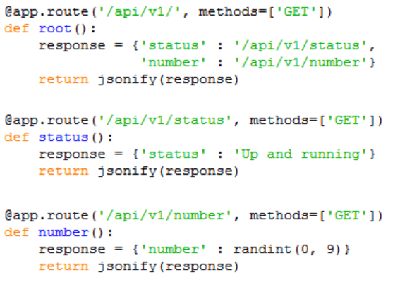
Sample Basic Rest API
Notes:
https://medium.com/studioarmix/learn-restful-api-design-ideals-c5ec915a430f

Slide 57
Composable Infrastructure

Slide 58
Composable Infrastructure
What?
Virtualize infrastructure: use compute, network and storage as services
Pools of resources are “composed” on demand based on app requirements (IaC)
Regardless of app running bare metal, VM or container
Provisioning done with a single unified API
It will use “disaggregated servers”, not bound by a chassis (CPU, RAM and IO)
Why?
App-centric provisioning provides performance app requires
More cost effective, ie no silos, no underutilized resources
As agile as public cloud providers
But maintaining the security and control of a private cloud

Slide 59
Composable Infrastructure
Limitations/Challenges
lack of industry standard around IO/Memory fabric at rack scale, which is needed for full composability
lack of management intelligence. Decision to map resources should be automatic based on the workload and decided by the technology
lack of industry standard around openness, allowing customers to allocate resources across multiple vendors’ technology.
What’s being done
Redfish/Swordfish industry standard APIs
Intel Rack Scale Architecture
Notes:
CPU to RAM ratio are mostly unchangeable. The CPU represents about two-thirds of the total system cost, and the rest (memory, I/O subsystem) typically doesn't need replacing as often as the processor
In order to disaggregate them we will need superfast fabric. CPU and RAM sit very close today. Disaggregation will imply larger distance.
Sillicon photonics is a technology being considered.
This technologies will be very costly
Ethernet or similar will likely introduce too much latency eroding the value of emerging memory technologies
Another challenges is the software required to provision and deprovision system resources . Intel's overall disaggregation initiative is known as Rack Scale Architecture
http://searchdatacenter.techtarget.com/feature/A-disaggregated-server-proves-breaking-up-can-be-a-good-thing
https://blog.dellemc.com/en-us/a-practical-view-of-composable-infrastructure/
http://en.community.dell.com/dell-blogs/dell4enterprise/b/dell4enterprise/archive/2016/06/02/reality-check-is-composable-infrastructure-ready-for-prime-time
https://youtu.be/Pjz5D3MwcGE

Slide 60
Homework

Slide 61
Homework 1 – Stock Portfolio Tracker
Two pages:
Form to input stocks to track
Use a fix number of stocks, ex: 3 stocks
3 columns: Number of shares of a given stock, Stock Exchange, Ticker symbol
Portfolio page shows current position and market value
Get the data from Google Finance API. Ex:
https://www.google.com/finance/info?client=ig&q=ASX:TLS
Bonus points - Use Vagrant to deploy in AWS EC2

Slide 62
Homework 2 – ANZ Weather Summary
Create an app with 2 microservices:
Python script to poll Weather Underground public API every 15 mins to collect current temperature data for all Australian state capitals. Store data in Redis
Display HTML table with latest data on demand. Display also current time
Use Vagrant/Ansible to deploy Linux OS and all required software (Python, Redis, etc) in your laptop. Run it on VirtualBox
IMPORTANT: In order to stay below the limits imposed by the Free Tier do all development work with only 2 cities and at the end expand the list

Slide 63
Homework 3 – Plot the ISS Trajectory
Poll the ISS API to find out longitude/latitude coordinates every 10 minutes
http://api.open-notify.org/iss-now.json
Use the “time” library to sleep for 10 minutes
Plot the trajectory over a world map with the 20 positions
Use GMPLOT library to create the map
Deploy in PCF

Slide 64
Homework 4 – Vagrant CoprHD and XtremIO
Go to https://coprhd.atlassian.net/wiki/x/ZIBLAQ
Follow instructions to do a Vagrant install in VirtualBox (option 4)
Log on to CoprHD – root / ChangeMe
DNS, NT, SMTP …
Register virtual XtremIO
Create VDC, Virtual Array, Virtual Pool, Project
then provision a volume

Slide 66
STaaS - ViPR

Slide 67
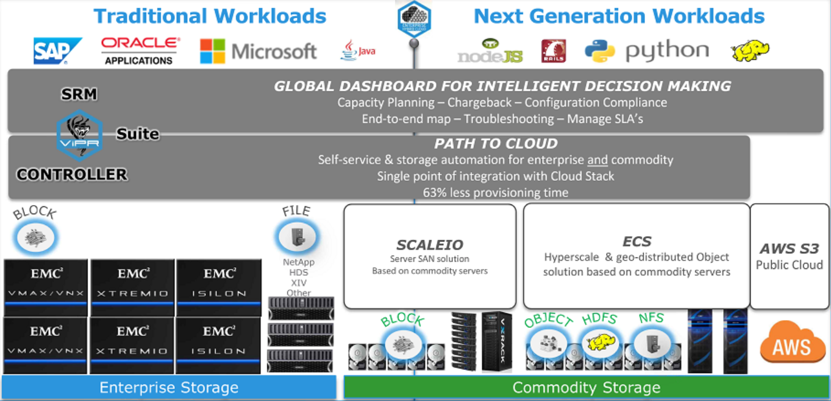
ViPR – Enable Digital & IT Transformation
Notes:
ViPR Controller supports SC arrays since Q4 2016

Slide 68









Integrate with Cloud Stacks
OpenStack
Automate Delivery of Storage Services via Open REST APIs
AUTOMATE STORAGE MANAGEMENT
ViPR Controller Service Catalog
Management Software
OPEN REST APIs
VIRTUAL STORAGE POOLS WITH DATA PROTECTION POLICIES
Create Policy-Based Virtual Storage Pools
Highest Performance
HA & DR Protection
High Performance
Local & Archive Protection
High Performance
DR, Local & Archive Protection
High Performance
DR & Archive Protection
Medium Performance
DR & Archive Protection
Medium Performance
Local Protection
Low Performance
Archive Protection
Low Performance
Local Protection
Create Virtual Storage Arrays
VIRTUAL STORAGE ARRAYS
Discover Physical Arrays
Notes:
The benefits of ViPR Controller are its ability to automate provisioning and deliver policy-based storage and data protection services. By centrally automating storage, administrators are freed up from repetitive, manual administrative tasks so they can focus on strategic, value-driven activities. In addition, ViPR Controller reduces the risk of human error and the need for lengthy management reviews, making an organization more agile and productive.
First physical arrays are discovered, once, within ViPR Controller. <click> Next, the storage team creates virtual storage arrays. Virtual arrays can consist of one or more physical arrays, depending on the logical grouping that’s required. <click> Virtual storage pools are created with performance, capacity and data protection characteristics. <click> Open REST APIs integrate with the ViPR Controller Service Catalog to provide an easy to use interface for storage teams to provision storage to consumers, or consumers can be given access to the self-service catalog where they can request storage on-demand. Additionally, the open REST APIs allow organizations to integrate ViPR Controller with other management automation software <click> as well as cloud stacks such as VMware, OpenStack and Microsoft.
ViPR Controller gives you the freedom to make the choice that's right for your business by providing the ability to automate and manage your storage infrastructure with one central software platform
ViPR Controller currently supports:
EMC Storage Platforms : EMC VMAX including the new VMAX3 with its SLO provisioning capabilities, VNX and VNX3, Isilon, ScaleIO and XtremIO
Third-party Storage Platforms: Hitachi, IBM, HP, SolidFire, NetApp and Oracle
Data Protection Technologies: VPLEX including VPLEX metro, local and Metropoint topographies, RecoverPoint, SRDF and Data Domain
Converged Infrastructures: VCE Vblock Systems
Cloud Stacks: OpenStack, VMware, and Microsoft
Additional platforms will be added in future releases.

Slide 69

ViPR Controller - Concepts
VDC = maps to a physical data center or a part of one
Virtual Array = all storage infrastructure that needs to be managed logically as one: storage systems and pools, and networks and ports
Virtual Pools = sets of physical storage with similar capabilities
Tenant = manages own environment, ex: multiple companies hosted by a Service Provider or multiple departments in an company
A Tenant can contain subtenants and users
Project = logical grouping of resources (block, file, …) for the purpose of authorization
Notes:
From “ViPR Technical Overview” PPT:
It all starts with the ViPR controller. The ViPR controller:
Recognizes all physical arrays, including EMC VMAX and VNX block storage, EMC Isilon and VNX file storage, EMC VPLEX, and third-party NetApp file (NAS) at first release.
The ViPR controller also:
Virtualizes your physical storage and configures your virtual storage arrays,
Automates storage tasks and delivers storage through a self-service catalog, and
Centralizes management across physical and virtual environments
Discovering and registering arrays is the first of 3 easy steps to virtualize, automate, and centralize storage.
Through an easy-to-use portal, the storage administrator defines the storage environment that it wants ViPR to manage. They point to storage arrays, SAN switches, and data protection devices. ViPR then discovers and abstracts physical storage arrays with all their unique capabilities into a single pool of virtual storage.
This is a very simple process. The storage administrator simply points to the array and ViPR discovers the rest.
This step only needs to be done at the beginning, when ViPR is first deployed, or at anytime the administrator wants to add or change the configuration
- Virtual Storage Array
Group all storage infrastructure that logically needs to be managed as one
Abstract to manage the entire storage in a physical data center, pods, or islands of storage
- Virtual Storage Pool
Collections of physical pools of similar capability
Key to policy-based management
https://www.emc.com/techpubs/vipr/what_is_virtual_array-3.htm
https://australia.emc.com/techpubs/vipr/tenant_multi_concepts-1.htm
https://australia.emc.com/techpubs/vipr/projects_and_consistency_groups-1.htm

Slide 70
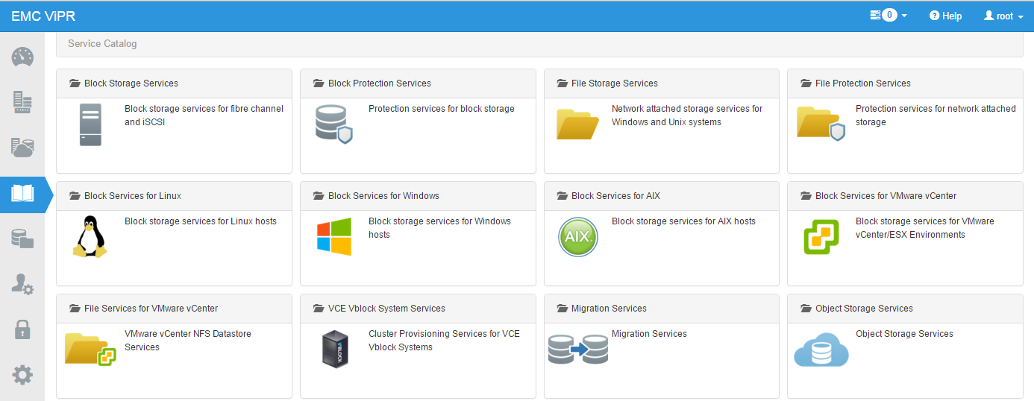
ViPR Self Service Catalog
Next release will include the “Custom Services”

Slide 71

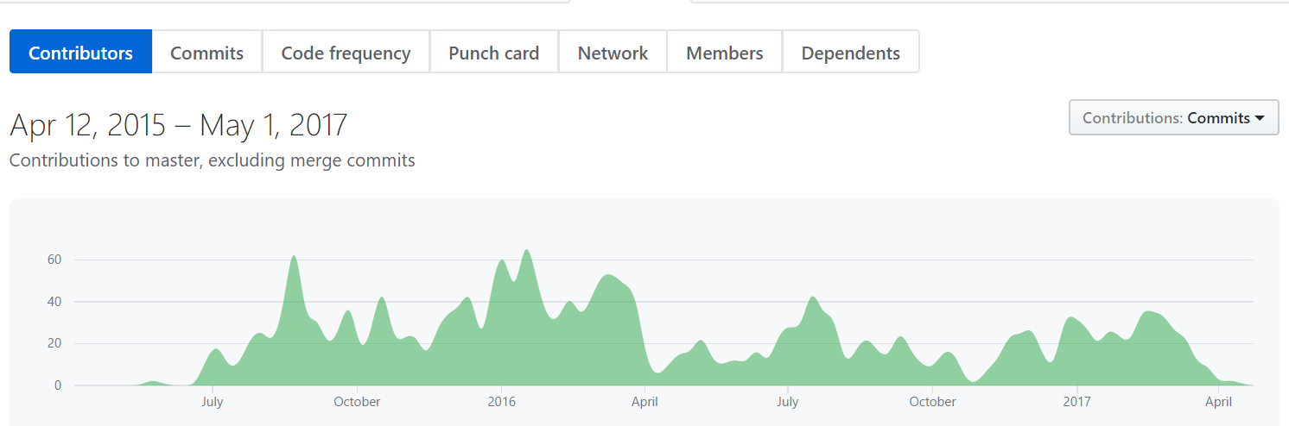
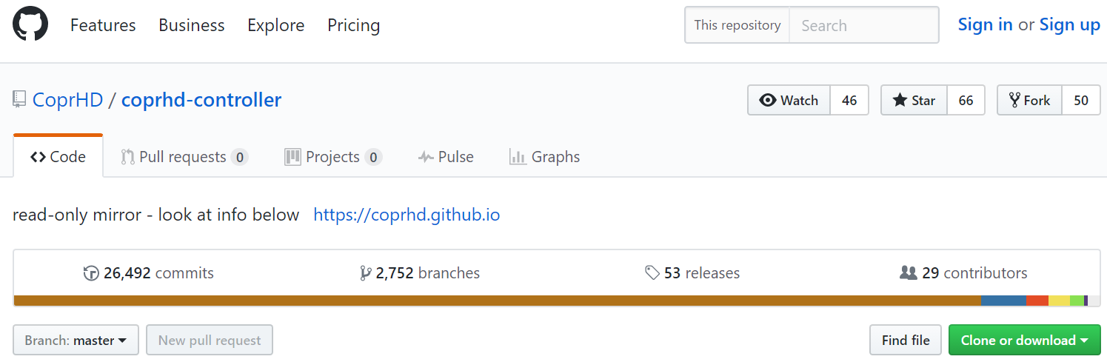
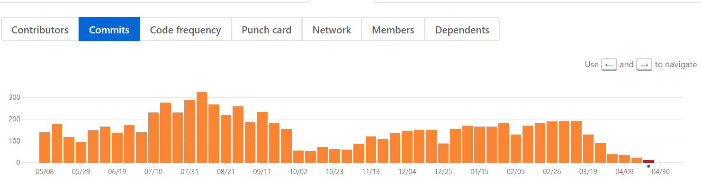
CoprHD
CoprHD is the Open Source version – Alive and kicking

Slide 72
Lab 8: Vagrant / ViPR
Let’s install CoprHD
Go to https://coprhd.atlassian.net/wiki/x/ZIBLAQ
Follow instructions to do a Vagrant install in VirtualBox (option 4)
Log on to CoprHD – root / ChangeMe
DNS, NT, SMTP …
Register virtual XtremIO
Create VDC, Virtual Array, Virtual Pool, Project
then provision a volume
Notes:
https://coprhd.atlassian.net/wiki/display/COP/How+to+Download+and+Build+CoprHD+%28controller+and+devkit%29+as+an+appliance
I will download the boxes in advance

Slide 73
Lab 9: ViPR controller Administration
Unzip the demo files and run index.htm
Add a storage systems (under “Physical Assets”)
Create a Virtual Array (cannot grant access to specific tenants in the demo)
Add Block Virtual pool
Add File Virtual pool
Use the Service Catalog to add a block
When finished, verify in Resources → Volumes that it was created
Notes:
Canned demo or CoprHD vagrant install later (both, first do the canned demo to provision storage, and do things I cannot do without hosts and later do the CoprHD install and discover XtremIO)
The following cannot be added with the demo Fabrics, Networks, Tenants, Projects, add Service to the Catalog

Slide 74
Lab 10 – ViPR API (Need to create repo)
Clone Repo repo

